Slide 1
Kapasa Makasa University
Department of Agriculture and Aquatic Sciences
Agribusiness Management (SA: 500)
Lecture 7: Financial Management for Agribusiness by
MR. Chama

Slide 2
Introduction
Financial Management within Agribusiness context is complex
Unlike traditional retail or manufacturing sectors, Agribusiness is characterised by:
Biological transformation, the processes of growth, degeneration, production, and procreation that cause qualitative or quantitative changes in living assets.
Effective bookkeeping is the starting point for tracking these transformations and converting them into actionable financial data.

Slide 3
The meaning of Financial Management
Financial Management: is a branch of management that focuses on managing money, recording transactions, and interpreting financial information to support decision-making and business growth.
It involves acquisition of fund at optimum cost and its utilization with minimum financial risk.
Financial management uses accounting information for decision making regarding the business
Accounting: is the process of identifying, measuring, summarizing and communicating economic information to permit informed judgements and decisions by users of the information.
The main objective of financial management is to maximise profit, often referred to as the “bottom line.”

Slide 4
Objectives
Lecture 7 is divided into two sessions:
(i) Bookkeeping
(ii) Financial analysis
By the end of lecture 7, students should be able to:
Prepare books of accounts (journals and ledgers)
Describe the bookkeeping process (accounting process)
Interpret financial statements
Calculate and interpret financial ratios

Slide 5
Session 1: Book-keeping
By the end of this session, students should be able to:
Describe the bookkeeping process (accounting process)
Prepare books of accounts (journals and ledgers)
Interpret financial statements

Slide 6
Definition of Book-keeping
The part of accounting that is concerned with recording data is known as bookkeeping.
Historically, all accounting data was recorded manually in books, hence the term ‘bookkeeping’.
Nowadays, most accounting data is recorded electronically on computers.
Bookkeeping is the process of recording data relating to accounting transactions in the accounting books.
It focuses on raw data collection (not analysis, which is accounting) to track assets, liabilities, income, and expenses.

Slide 7
The Importance of Bookkeeping in Agribusiness
Bookkeeping is an important source of Accounting Information needed for:
(1) Internal financial decision making
(2) External use
(1) Internal financial decision making
(i) Agribusiness managers need to know:
Whether the business is making a profit or a loss
What transactions were worth it
How much the business owes and what is owed.
(ii) Owner(s) of the business need to be able to see whether or not the business is profitable.

Slide 8
The Importance of Bookkeeping in Agribusiness Cont.…
(ii) External Use
A prospective buyers and partners need see accounting information before buying the business.
Investors, either existing ones or potential ones need accounting information to know whether or not to invest their money in the business.
The bank demands to see accounting information before approving a loan.
Tax inspectors need accounting information to be able to calculate the taxes payable.

Slide 9
Best practices in bookkeeping
Record transactions as soon as they occur
Go through your books at least once a week
Set up contacts of your suppliers and customers
Reconcile your account(s) at the end of every month
Run weekly and/or monthly reports.
Do not combine your personal finances with the business money

Slide 10
Financial organization
Any agribusiness needs to keep track of its business transactions daily.
A transaction is simply any financial event such as buying or selling an item, making or receiving payments.
Bookkeeping is needed to keep these transactions orderly and systematic during a specified business period.
Organisation of Financial transactions starts with Bookkeeping

Slide 11
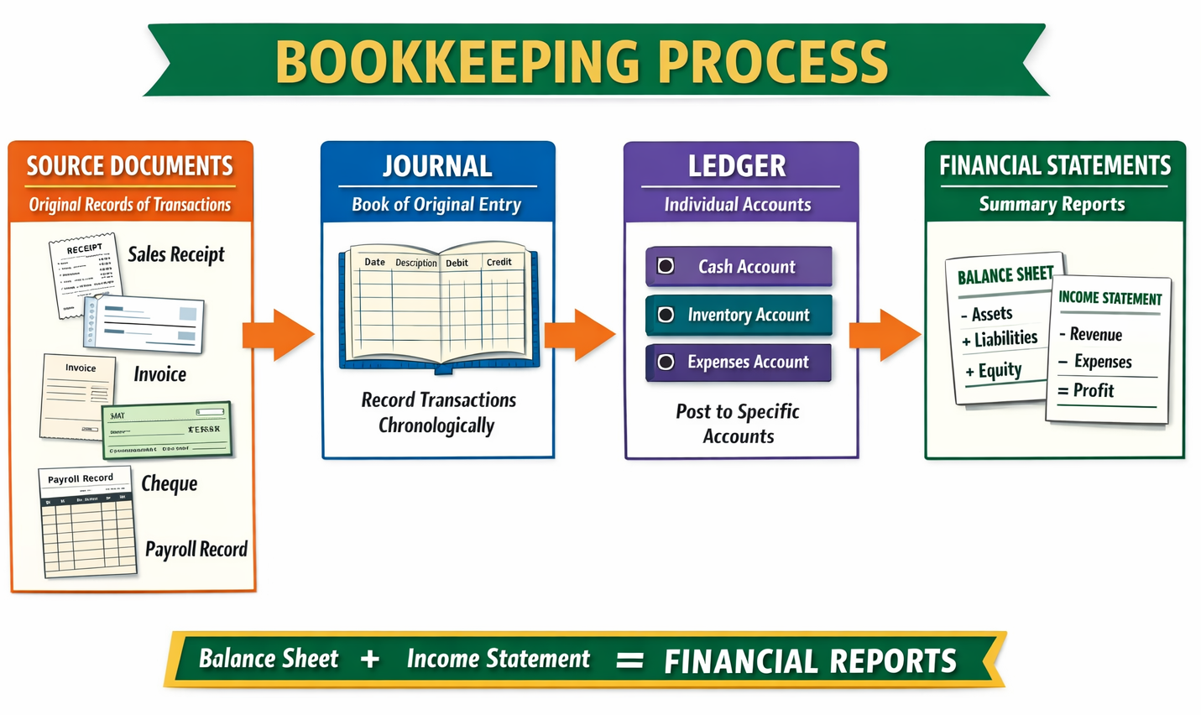

Slide 12
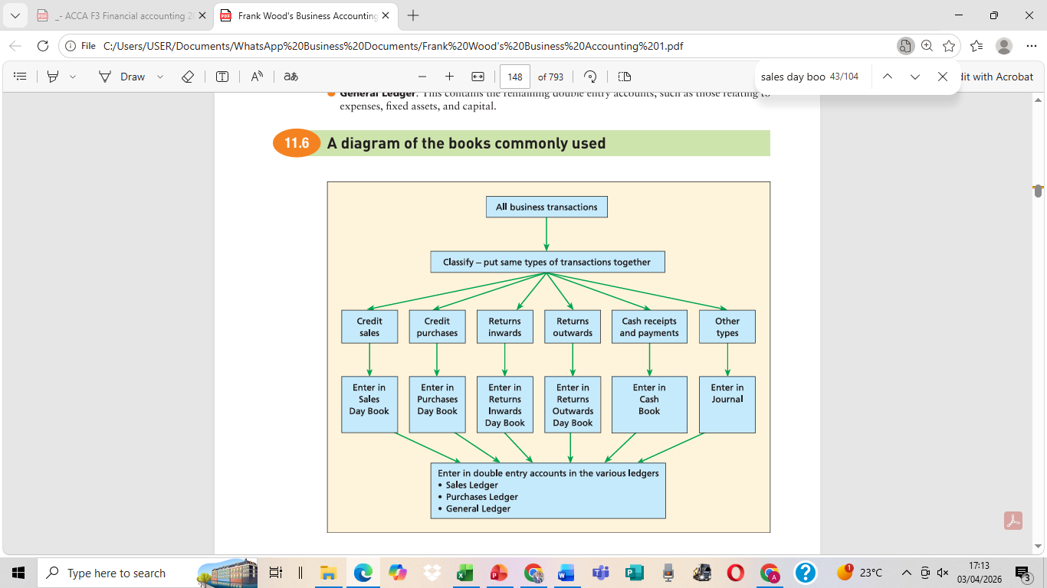

Slide 13
Bookkeeping process (accounting process)
Steps:
Transaction.
Collect source documents (invoices, receipts).
Record in journals (also known as books of primary entry).
Post to ledgers.
Trial balance to check debits = credits.
Prepare financial statements.

Slide 14
(1) Source documents
Source Documents are written or printed records, which provide proof of a Business Transaction.
Journals are prepared using source documents.
The design of each document differs from one Business to the other, but all of them will contain similar information.
Importance of Source Documents
a) They provide proof of occurrence of a transaction.
b) They ensure correct and accurate details of a business transaction.
c) They provide reference for entries of transactions into journals
d) They help in resolving disputes related to payments

Slide 15
Examples of Source Documents
Quotation: A document stating the fixed price for goods or services.
Invoice: A request for payment for goods or services sold on credit.
Receipt: A document confirming receipt of payment.
Purchase Order: A document detailing goods a business wishes to purchase.
Sales Order: A document detailing an order placed by a customer.
Goods Received Note (GRN): A document listing goods received from a supplier.
Goods Despatched Note: A document listing goods sent to a customer.
Credit Note: A document for goods returned or overpayments. A negative invoice.
Debit Note: A document requesting a supplier to issue a credit note. Request for refund due to poor-quality inputs
Remittance Advice: Sent with payment, showing which invoices are being paid.

Slide 16
(2) Journals (Day Books) or Books of Primary Entry
Journals (Day Books) also known as Books of Primary/Original Entry are books where transactions are first recorded directly from Source Documents in chronological order. These include:
(a) Purchases Day Book (Purchases Journal or Creditors): Credit purchases
(b) Purchases Returns Day Book (Returns Outwards Journal): Returned purchases
(c) Sales Day Book (Sales Journal or Debtors): Credit sales
(d) Sales Returns Day Book (Returns Inwards Journal): Returned Credit Sales
(e) Cash Book: Cash receipts and payments
(f) Petty Cash Book: small regular expenses
(g) General Journal: General transactions

Slide 17
Journals and their respective Source Documents
Source Document | Journal
Purchases Invoice | Purchases Day Book
Credit Note | Purchases Returns Day Book
Sales Invoice | Sales Day Book
Credit Note | Sales Returns Day Book
Receipt, Cheque, Bank Statement | Cash Book
Petty Cash Voucher | Petty Cash Book
Various Source Documents | General Journal

Slide 18
(3) Posting to Ledgers
Ledgers are summaries (totals) of all the transactions listed in the books of prime entry into various accounts.
There are three types of Ledgers:
(i) Purchases Ledgers where all the individual accounts for creditors are posted or kept.
(ii) Sales Ledger, where all the individual accounts for debtors are posted or kept.
(iii) The general (nominal) ledger, where the summaries (totals) for all accounts are posted.

Slide 19
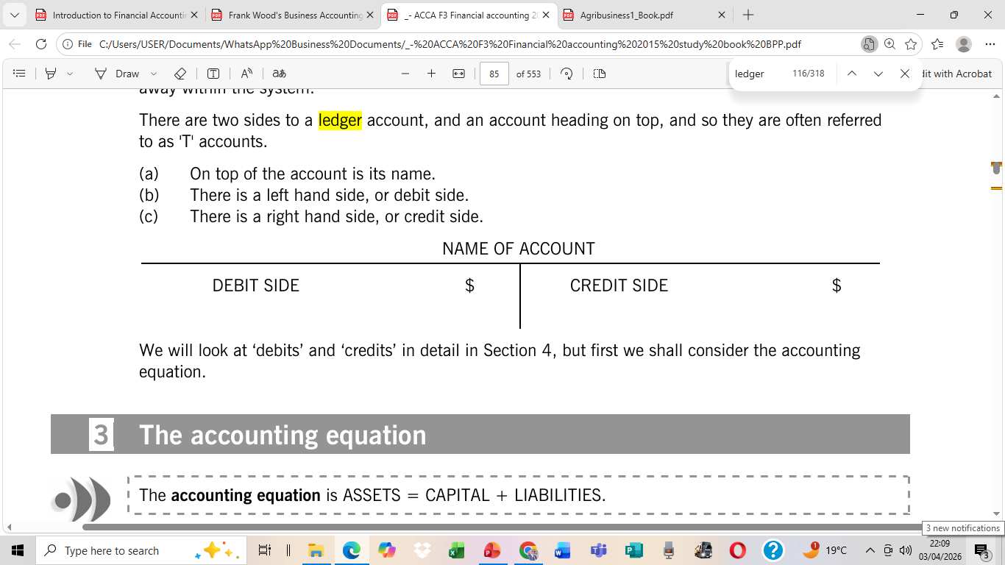
Ledger Accounts
Ledgers consist of a large number of different accounts, each account having its own purpose or 'name' and an identity or code.
There are two sides to a ledger account, and an account name heading on top, and so they are often referred to as 'T' accounts.
The left-hand side is always a debit side and the right-hand side, credit side.

Slide 20
General (nominal) Ledger
A general ledger is a principal accounting book in which all the accounts are recorded.
Every accounting event must be entered in ledger accounts both as a debit and as an equal but opposite credit. This is referred to as Double Entry.
Double-entry bookkeeping is based on the idea that each transaction has an equal but opposite effect.
The double entry principle is premised on the accounting equation.
The accounting equation is: ASSETS = CAPITAL + LIABILITIES and

Slide 21
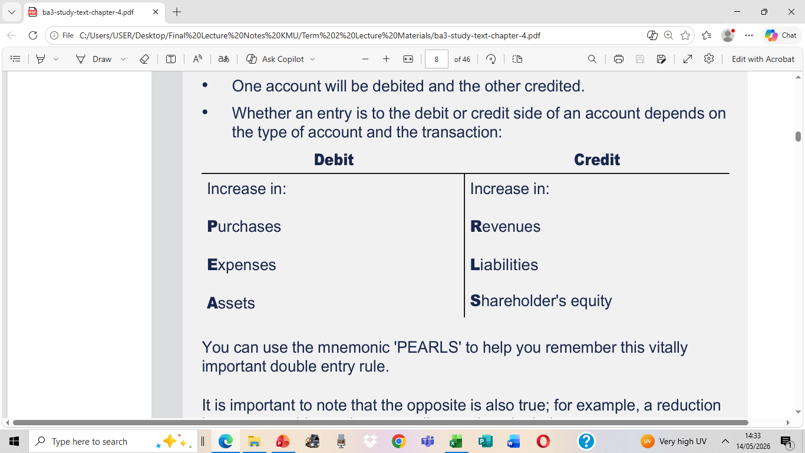
Example of Accounts in the General Ledger
The general ledger consists of accounts for assets, liabilities, capital, income (revenue or sales), expenditure (expense), and so profit and loss.
The asset and liability accounts go into the statement of financial position.
The revenue and expense accounts will help to form the statement of profit or loss
For debit & Credit entry, always remember (PEA-LER)

Slide 22
(4) Preparation of Trial Balance
A trial balance is a list of ledger balances shown in debit and credit columns.
At suitable intervals, the entries in each ledger account are totalled and a balance is struck.
Balances in a trial balance are used as a basis for preparing financial statements; (i) a statement of profit or loss and (ii) a statement of financial position.

Slide 23
(5) Financial Statements
Definition of Financial Statements
Financial statements are a summarised statement of the financial status of a business, prepared as a summary of accounts from the trial balance.
The primary financial statements consist include:
Statement of profit or loss (Income Statement)
Statement of Financial Position (Balance Sheet)
Additional statements include:
Statement of Owner’s Equity
Statement of Cash Flows

Slide 24
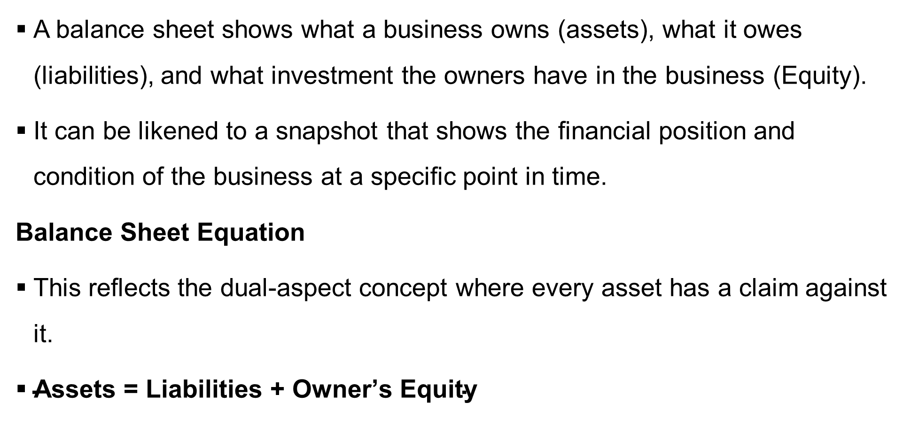
Statement of Financial Position (Balance Sheet)

Slide 25
Components of a Balance Sheet
Assets
Assets are financial resources that have monetary value. Assets are classified into three categories:
a) Current Assets
Current assets are cash or assets that will be converted to cash during one normal operating cycle of the business (usually one year).
Examples:
Cash
Accounts receivable
Inventory
Prepaid expenses
Marketable securities
b) Non-current Assets (Fixed Assets)
Fixed assets are those items that the business owns that have a relatively long life.
Examples:
Land
Buildings
Equipment
Machinery
Depreciation is the loss in value due to use, wear and tear on fixed assets.
c) Other Assets
These include:
Investments
Patents
Copyrights
Goodwill

Slide 26
Components of a Balance Sheet (Continued)
2. Liabilities
Liabilities consist of money that the business owes to outsiders. Two types:
a) Current Liabilities
These are obligations due within one operating cycle (one year).
Examples:
Accounts payable
Notes payable
Accrued expenses
Customer advances
b) Long-term Liabilities
These are debts not due within one year.
Examples:
Mortgages
Long-term bank loans
Bonds

Slide 27
Components of a Balance Sheet (continued)
3. Owner’s Equity
Owner’s equity is the value of assets over and above the firm’s liabilities.
It is also referred to as net worth.
Components may include:
Common stock (owner investment)
Retained earnings (profits kept in the business)

Slide 28
Example of a Balance Sheet
ASSETS | ZMW
Current Assets
Cash | 120,000
Accounts Receivable (customers who bought mealie meal on credit) | 80,000
Inventory (maize grain and mealie meal stock) | 250,000
Prepaid Insurance | 10,000
Total Current Assets | 460,000
Non-current Assets
Land | 300,000
Milling Machinery | 500,000
Less: Accumulated Depreciation | (120,000)
Delivery Truck | 200,000
Less: Accumulated Depreciation | (50,000)
Total Fixed Assets | 830,000
Total Assets | 1,290,000
LIABILITIES AND OWNER’S EQUITY | ZMW
Current Liabilities
Accounts Payable (maize suppliers) | 150,000
Short-term Bank Loan | 120,000
Accrued Wages | 30,000
Total Current Liabilities | 300,000
Long-Term Liabilities
Bank Loan for Milling Equipment | 250,000
Total Long-Term Liabilities | 250,000
Total Liabilities | 550,000
Owner’s Equity
Owner Capital | 500,000
Retained Earnings | 240,000
Total Owner’s Equity | 740,000
Total Liabilities + Owner’s Equity | 1,290,000

Slide 29
Income Statement (Statement of Profit or Loss)
The income statement is a summary of business operations over a certain period.
It is also known as:
Operating statement
Profit and loss statement
It demonstrates financial changes since the last time a balance sheet was prepared.

Slide 30
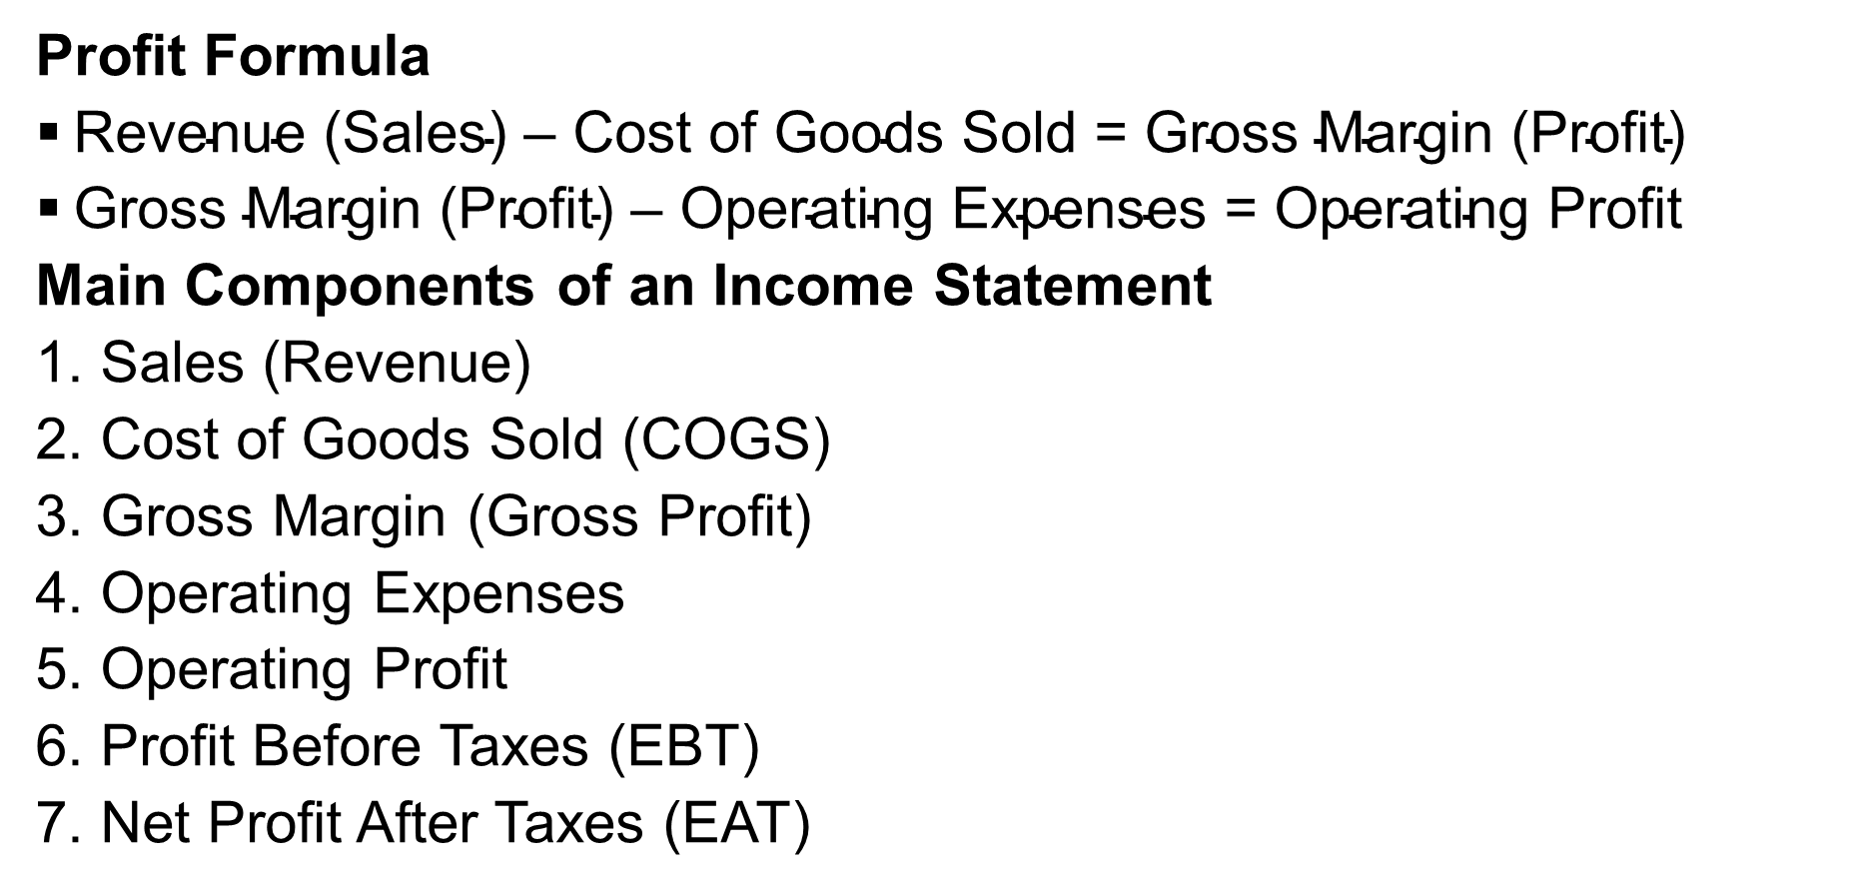
Income Statement (Continued)

Slide 31
Income Statement (Statement of Profit or Loss)
Item | Amount (ZMW)
Sales Revenue
Broiler chicken sales | 420,000
Egg sales | 180,000
Gross Sales | 600,000
Less: Returns and Discounts | (20,000)
Net Sales | 580,000
Cost of Goods Sold
Poultry feed | 200,000
Day-old chicks | 90,000
Veterinary drugs and vaccines | 25,000
Total Cost of Goods Sold | 315,000
Gross Profit (Margin) | 265,000
Operating Expenses
Farm labour wages | 70,000
Electricity and water | 20,000
Transport and delivery | 25,000
Repairs and maintenance | 10,000
Depreciation of poultry equipment | 15,000
Total Operating Expenses | 140,000
Net Operating Income | 125,000
Interest on bank loan | (15,000)
Net Income Before Tax | 110,000
Tax expense | (30,000)
Net Income After Tax (Profit) | 80,000

Slide 32
Class Activity 1: Bookkeeping Process
Chinsali Poultry Farm recorded the following transactions for June 2026, all in Zambian Kwacha (ZMW):
June 1: Owner invested 200,000 into the bank.
June 2: Bought on credit from Lusaka Feed Mills: 100 bags of feed @ 348 each (Total 34,800).
June 3: Bought on credit from Agro-Vet Ltd: 500 chicks @ 11.60 each (Total 5,800).
June 4: Bought on credit from Lusaka Feed Mills: 20 Drinkers @ 116 each (Total 2,320).
June 5: Returned 5 bags of spoiled feed to Lusaka Feed Mills (1,740).
June 6: Returned 10 dead chicks to Agro-Vet Ltd (116).
June 7: Returned 2 cracked drinkers to Lusaka Feed Mills (232).

Slide 33
Class Activity: Bookkeeping Process
June 10: Sold on credit to Kafue Hotel: 100 chickens @ 116 each (Total 11,600).
June 11: Sold on credit to Zambezi Lodge: 50 chickens @ 116 each (Total 5,800).
June 12: Sold on credit to Central Market: 80 chickens @ 116 each (Total 9,280).
June 13: Kafue Hotel returned 5 chickens for the wrong weight (580).
June 14: Zambezi Lodge returned 2 chickens for damaged packaging (232).
June 15: Central Market returned 3 chickens (348).
June 20: Paid Lusaka Feed Mills 20,000 by cheque.
June 21: Received 10,000 cheque from Kafue Hotel.
June 22: Cashed a cheque of 2,000 for Petty Cash.
June 25: Paid Petty Cash for: Labour (500), Transport (300), Stationery (100).
Required:
Record the above transactions into the appropriate books of original entry and respective ledgers. Then, prepare a Trial Balance as at 30 June 2026.

Slide 34
Class Activity: Bookkeeping Process Solution
Step 1: Analyse each transaction and enter it into the appropriate journals.
June 1: Owner invested 200,000 into the bank.
Capital A/c= K200, 000 (Credit)
Bank A/c = K200, 000 (Debit)
Records:
Purchase of fixed assets, e.g., the purchase of a tractor
It captures non-routine entries, such as opening balances, depreciation, asset purchases on credit, and correcting errors.
General Journal
Applies Double Entry Principle:
Each transaction has two effects, both as a debit and as an equal but opposite credit.
One account receives/gains (debits) financial value – debit (Dr)
The opposite account gives/loses (credits) the same financial value – Credit (Cr)
-
PEA-LER
PEA (P – Purchases, E – Expenses, A – Assets) Debit when they increase.
LER (L – Liabilities, Equity (capital), Revenue):
Double entry applies only to entries in the General journal & Ledger Accounts

Slide 35
General Journal
For Agribusiness Book-keeping Concepts, this journal also accounts for:
Biological Assets: Living items (crops/livestock) with value changes (e.g., weight gain).
Consumable Stores: Items like fertiliser, feed, and seeds.
Fair Value: Agribusiness often adjusts the value of assets based on growth (e.g., a calf becoming a cow).
The Narration: Never skip the brackets at the bottom of an entry. Use "Being..." or "To record..." to explain what happened.
Biological Increases: When an animal is born or a plant matures, you debit the Asset and credit a Gain account because the business's value increased without a direct sale.

Slide 36
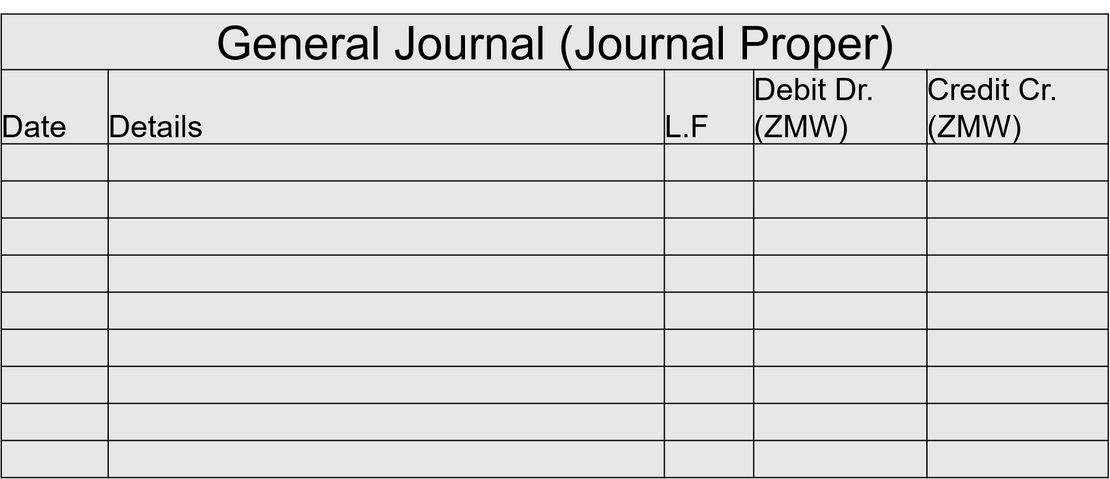
Format of the General Journal
Bank a/c
G.L
200, 000.00
Jun-1
Capital a/c
G.L
200, 000.00
(Being initial capital introduced by the owner into the bank)

Slide 37
Class Activity: Bookkeeping Process Solution
Accounts Payable (LFM) A/c = K34, 800 (Credit)
June 2: Bought on credit from Lusaka Feed Mills: 100 bags of feed @ 348 each (Total 34,800).
June 3: Bought on credit from Agro-Vet Ltd: 500 chicks @ 11.60 each (Total 5,800).
June 4: Bought on credit from Lusaka Feed Mills: 20 Drinkers @ 116 each (Total 2,320).
Purchases (Feed) A/c = K34,000 (Debit)
Records goods purchased on credit for resale
Records credit purchases of goods intended for use in production (Feed & Chicks).
Applies the single-entry principle. No need to enter the debit and credit sides.
Transactions are entered in chronological order
Purchases Journal (Purchases Day Book)

Slide 38
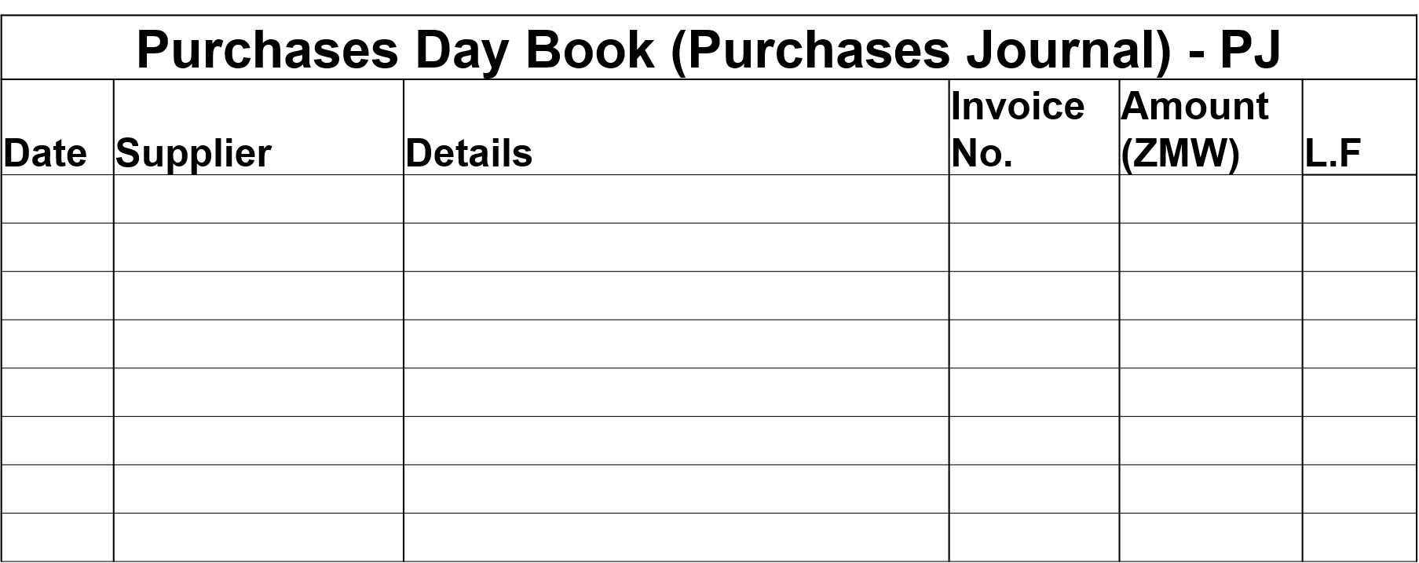
Purchases Day Book (Purchases Journal) Format
Jun- 2
Lusaka Feed Mills
100 bags of feed @ 348 each
LFM- 12
34,800.00
PL 01
Jun- 3
Agro-Vet Ltd
500 chicks @ 11.60 each
AV - 30
5,800.00
PL 02
Jun- 4
Lusaka Feed Mills
20 Drinkers @ 116 each
LFM- 15
2,320.00
PL 03
Total
42, 920.00

Slide 39
Class Activity: Bookkeeping Process Solution
June 5: Returned 5 bags of spoiled feed to Lusaka Feed Mills (1,740).
June 6: Returned 10 dead chicks to Agro-Vet Ltd (116).
June 7: Returned 2 cracked drinkers to Lusaka Feed Mills (232).
Records goods returned to suppliers due to defects or damage
Applies the single-entry principle. No need to enter the debit and credit sides.
Transactions are entered in chronological order
Purchases Returns Journal (Returns Outwards Journal)

Slide 40
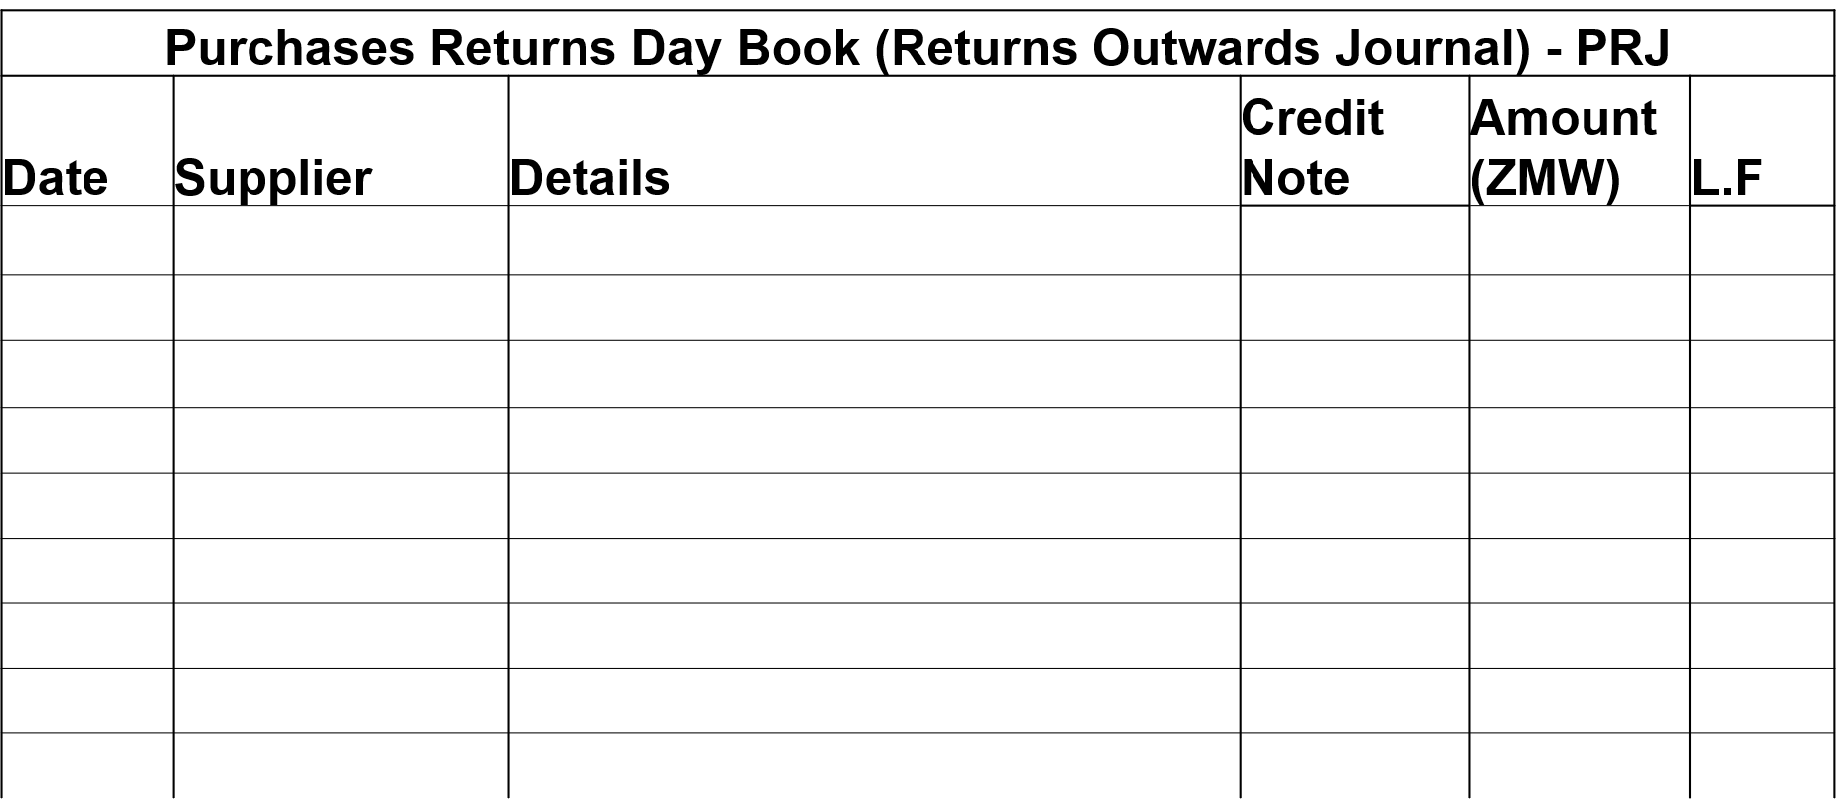
Purchases Returns Day Book Format
Jun- 5
Lusaka Feed Mills
Returned 5 bags of spoiled feed
CN- 51
1,740.00
PL 01
Jun- 6
Agro-Vet Ltd
Returned 10 dead chicks
CN - 23
116.00
PL 02
Jun- 7
Lusaka Feed Mills
Returned 2 cracked drinkers
CN- 55
232.00
PL 03
Total
2,088.00

Slide 41
Class Activity: Bookkeeping Process Solution
June 10: Sold on credit to Kafue Hotel: 100 chickens @ 116 each (Total 11,600).
June 11: Sold on credit to Zambezi Lodge: 50 chickens @ 116 each (Total 5,800).
June 12: Sold on credit to Central Market: 80 chickens @ 116 each (Total 9,280).
Records goods sold on credit
Applies the single-entry principle. No need to enter the debit and credit sides.
Transactions are entered in chronological order
Sales Journal (Sales Day Book)

Slide 42
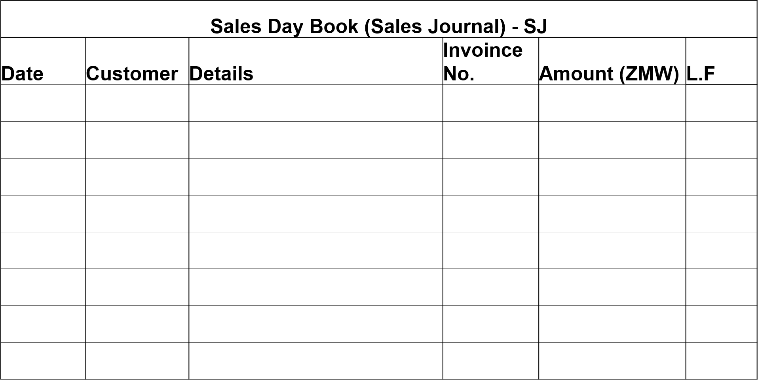
Sales Day Book Format
Jun- 10
Kafue Hotel
100 chickens @ 116 each
INV-01
11,600.00
SL 01
Jun- 11
Zambezi Lodge
50 chickens @ 116 each
INV-02
5,800.00
SL 02
Jun- 12
Central Market
80 chickens @ 116 each
INV-03
9,280.00
SL 03
Total
26,680.00

Slide 43
Class Activity: Bookkeeping Process Solution
June 13: Kafue Hotel returned 5 chickens for the wrong weight (580).
June 14: Zambezi Lodge returned 2 chickens for damaged packaging (232).
June 15: Central Market returned 3 chickens (348).
Records goods returned by customers who purchased on credit often due to reasons like poor quality, damage in transit or wrong specification.
Applies the single-entry principle. No need to enter the debit and credit sides.
Transactions are entered in chronological order
Sales Returns Journal (Returns Inwards Journal)

Slide 44
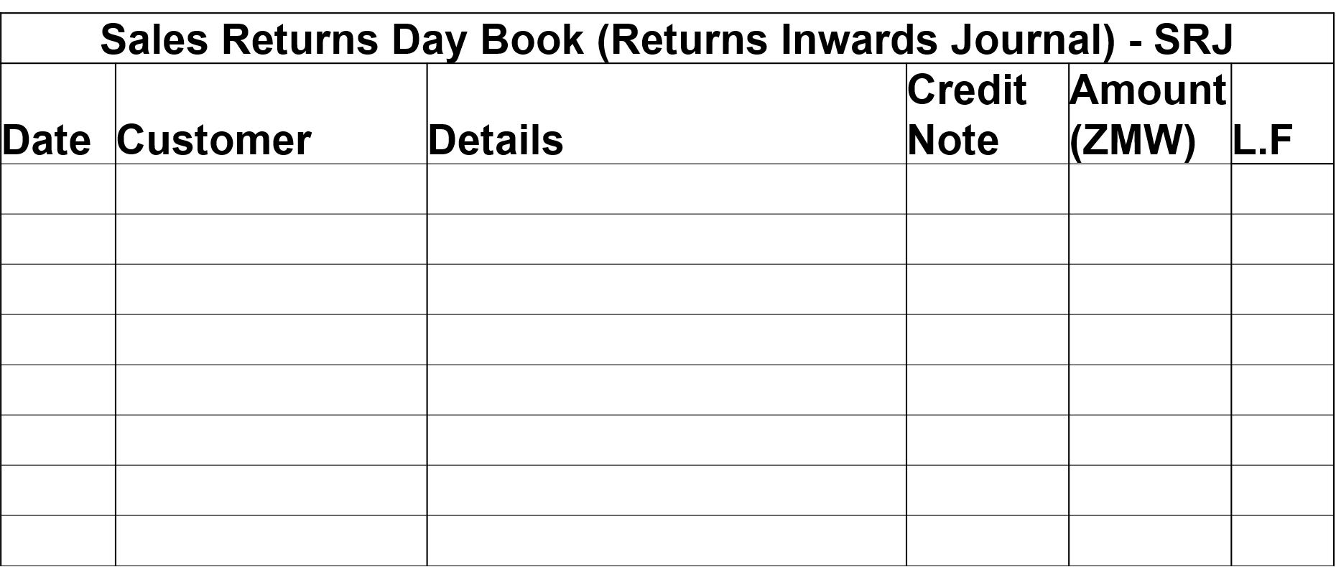
Sales Returns Day Book Format
Jun- 13
Kafue Hotel
5 chickens returned for wrong wet
CN-01
580.00
SL 01
Jun- 14
Zambezi Lodge
2 chickens returned for damage
CN-02
232.00
SL 02
Jun- 15
Central Market
3 chickens
CN-03
348.00
SL 03
Total
1,160.00

Slide 45
Class Activity: Bookkeeping Process Solution
June 20: Paid Lusaka Feed Mills 20,000 by cheque.
June 21: Received 10,000 cheque from Kafue Hotel.
June 22: Cashed a cheque of 2,000 for Petty Cash.
June 25: Paid Petty Cash for: Labour (500), Transport (300), Stationery (100).
Cash Book
Petty Cash Book
Records any cash in and cash out, either by cash or bank transaction.
Records cash receipts and payments in chronological order.
Cash books can be: single column (Cash or Bank only) or double column (Cash & Bank) or three column (Cash, Bank & Discount)
Records small (petty) payments for regular administrative activities & other none scheduled activities that require immediate payment e.g. transport, talk time, data bundle, stationary, labour, etc.

Slide 46
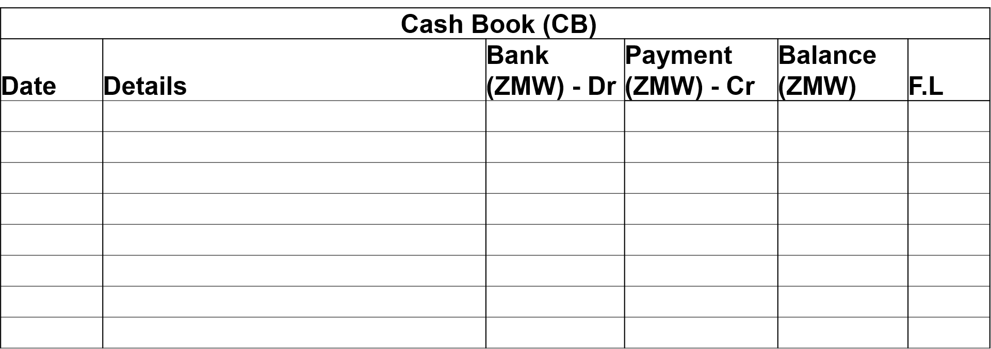
Cash Book Format (Single Column)
Jun- 1
Capital
200,000.00
200,000.00
G.L
Jun- 20
Lusaka Feed Mills
20,000.00
180,000.00
G.L
Jun- 21
Kafue Hotel
10,000.00
190,000.00
G.L
Jun- 22
Petty Cash
2,000.00
188,000.00
G.L
Total
210,000.00
22,000.00
188,000.00

Slide 47
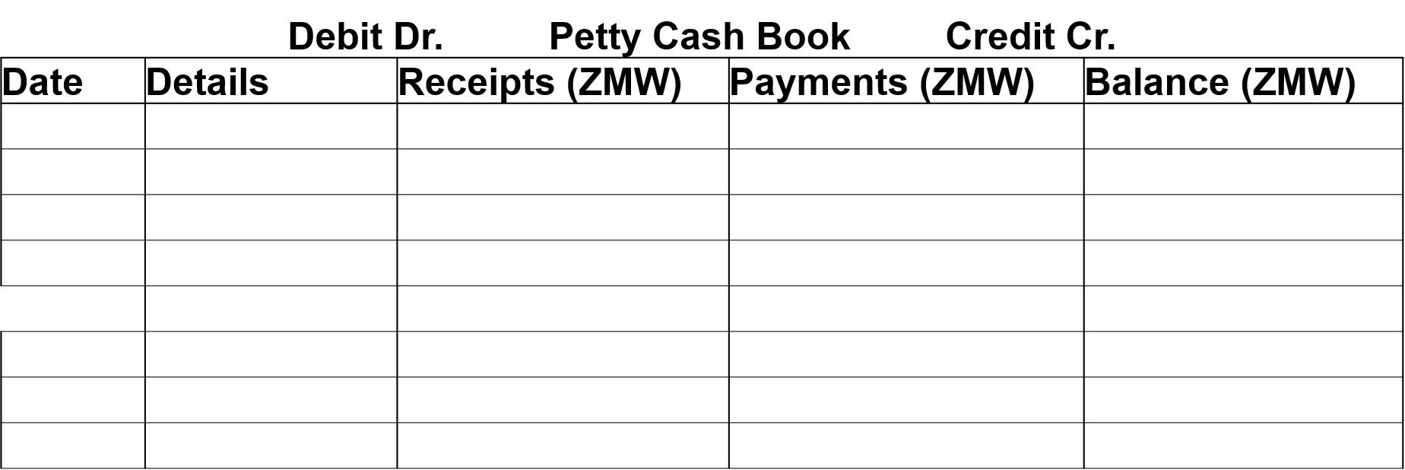
Petty Cash Book Format
Jun- 22
Petty Cash
2,000.00
2,000.00
Jun- 25
Labour
500.00
1,500.00
Jun- 25
Transport
300.00
1,200.00
Jun- 25
Stationary
100.00
1,100.00
Total
2,000.00
900.00
1,100.00

Slide 48
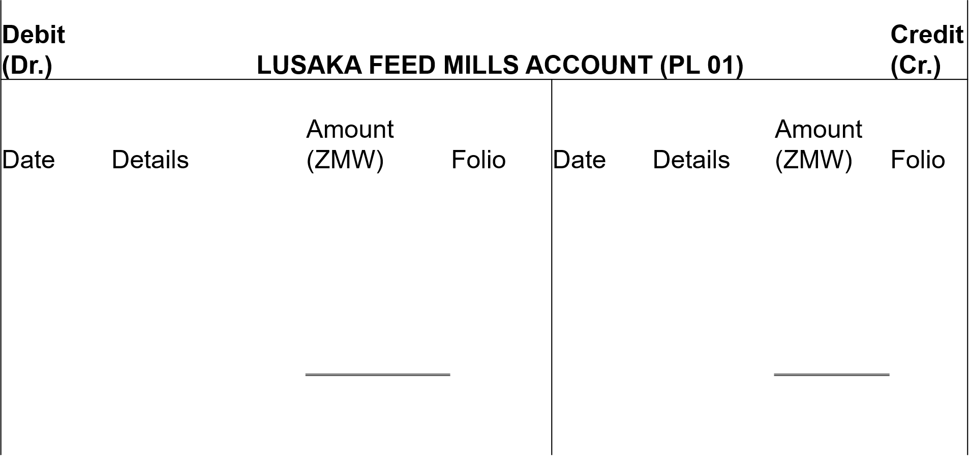
Purchases Ledger (Creditors) PL: Class Activity
Jun- 5
Purchases Returns
(Feed)
1,740.00
PRJ
Jun- 2
Purchases (Feed)
34,800.00
PJ
Jun- 7
Purchases Returns
(Drinkers)
232.00
PRJ
Jun- 4
Purchases (Drinkers)
2,320.00
PJ
Jun- 20
Bank (Feed)
20,000.00
CB
Jun- 30
Balance c/d
15,148.00
Total
37,120.00
Total
37,120.00
Jul- 1
Balance b/d
15,148.00

Slide 49
Purchases Ledger (Creditors) PL continues…
Jun- 6
Purchases Returns
(Chicks)
116.00
PRJ
Jun- 3
Purchases (Chicks)
5,800.00
PJ
Jun- 30
Balance c/d
5,684.00
Total
5,800.00
Total
5,800.00
Jul- 1
Balance b/d
5,684.00

Slide 50
Sales Ledger (Debtors) SL
Jun-10
Sales (Chickens)
11,600.00
SJ
Jun- 13
Sales Returns (Chickens)
580.00
SRJ
Jun- 21
Bank (Chickens)
10,000.00
CB
Jun- 30
Balance c/d
1,020.00
Total
11,600.00
Total
11,600.00
Jul- 1
Balance b/d
1,020.00

Slide 51
Sales Ledger (Debtors) SL continues…
Jun-11
Sales (Chickens)
5,800.00
SJ
Jun-14
Sales Returns (Chickens)
232.00
SRJ
Jun- 30
Balance c/d
5,568.00
Total
5,800.00
Total
5,800.00
Jul- 1
Balance b/d
5,568.00

Slide 52
Sales Ledger (Debtors) SL continues…
Debit (Dr.) | CENTRAL MARKET ACCOUNT (SL 03) | Credit (Cr.)
Jun-12
Sales (Chickens)
9,280.00
SJ
Jun-14
Sales Returns (Chickens)
348.00
SRJ
Jun- 30
Balance c/d
8,932.00
Total
9,280.00
Total
9,280.00
Jul- 1
Balance b/d
8,932.00

Slide 53
Sales & Purchases Ledgers Summary
Purchases Ledger Summary
Accounts Payable Control Account (Creditors)
Account Name | Balance b/d (ZMW)- Cr.
Lusaka Feed Mills Account | 15,148.00
Agro-Vet Ltd Account | 5,684.00
Total | 20,832.00
Sales Ledgers Summary
Accounts Receivable Control Account (Debtors)
Account Name | Balance b/d (ZMW)- Dr.
Kafue Hotel Account | 1,020.00
Zambezi lodge Account | 5,568.00
Central Market Account | 8,932.00
Total | 15,520.00

Slide 54
General Ledger: Class Activity
Debit (Dr.) | Capital Account |  |  |  |  |  | Credit (Cr.)
Date | Details | Amount | Folio | Date | Details | Amount | Folio
 |  |  |  | Jun-01 | Bank | 200,000.00 | GJ
Jun-30 | Balance c/d | 200,000.00
Total |  | 200,000.00 |  | Total |  | 200,000.00
 |  |  |  | Jul-01 | Balance b/d | 200,000.00
Debit (Dr.) | Bank Account |  |  |  |  |  | Credit (Cr.)
Date | Details | Amount | Folio | Date | Details | Amount | Folio
Jun-01 | Capital | 200,000.00 | GJ | Jun-20 | Lusaka Feed Mills | 20,000.00 | CB
Jun-26 | Kafue Hotel | 10,000.00 | CB | Jun-26 | Petty Cash | 2,000.00 | CB
 |  |  |  | Jun-30 | Balance c/d | 188,000.00
Total |  | 210,000.00 |  | Total |  | 210,000.00
Jul-01 | Balance b/d | 188,000.00
Debit (Dr.) | Petty Cash Account |  |  |  |  |  | Credit (Cr.)
Date | Details | Amount | Folio | Date | Details | Amount | Folio
Jun-22 | Bank | 2,000.00 | PCB | Jun-25 | Labour Expense | 500.00 | PCB
 |  |  |  | Jun-25 | Transport Expense | 300.00 | PCB
 |  |  |  | Jun-25 | Stationary Expense | 100.00 | PCB
 |  |  |  | Jun-30 | Balance c/d | 1,100.00
Total |  | 2,000.00 |  | Total |  | 2,000.00
Jul-01 | Balance b/d | 1,100.00

Slide 55
General Ledger: Class Activity continues…
Debit (Dr.) | Accounts Receivable Control Account |  |  |  |  |  | Credit (Cr.)
Date | Details | Amount | Folio | Date | Details | Amount | Folio
Jun-30 | sales | 26,680.00 | SJ | Jun-30 | Sales Returns | 1,160.00 | SRJ
 |  |  |  | Jun-30 | Bank (Kafue) | 10,000.00 | CB
 |  |  |  | Jun-30 | Balance c/d | 15,520.00
Total |  | 26,680.00 |  | Total |  | 26,680.00
Jul-01 | Balance b/d | 15,520.00
Debit (Dr.) | Accounts Payable Control Account |  |  |  |  |  | Credit (Cr.)
Date | Details | Amount | Folio | Date | Details | Amount | Folio
Jun-30 | Purchases Returns | 2,088.00 | PRJ | Jun-30 | Purchases | 42,920.00 | PJ
Jun-30 | Bank | 20,000.00 | CB
Jun-30 | Balance c/d | 20,832.00
Total |  | 42,920.00 |  | Total |  | 42,920.00
 |  |  |  | Jul-01 | Balance b/d | 20,832.00
Debit (Dr.) | Purchases Account |  |  |  |  |  | Credit (Cr.)
Date | Details | Amount | Folio | Date | Details | Amount | Folio
Jun-30 | Accounts Payable | 42,920.00 | PJ | Jun-30 | Balance c/d | 42,920.00
Total |  | 42,920.00 |  | Total |  | 42,920.00
Jul-01 | Balance b/d | 42,920.00

Slide 56
General Ledger: Class Activity continues…
Debit (Dr.) | Sales Account |  |  |  |  |  | Credit (Cr.)
Date | Details | Amount | Folio | Date | Details | Amount | Folio
Jun-30 | Balance c/d | 26,680.00 | SJ | Jun-30 | Accounts receivable | 26,680.00 | SJ
Total |  | 26,680.00 |  | Total |  | 26,680.00
 |  |  |  | Jul-30 | balance b/d | 26,680.00
Debit (Dr.) | Sales Returns Account |  |  |  |  |  | Credit (Cr.)
Date | Details | Amount | Folio | Date | Details | Amount | Folio
Jun-30 | Accounts receivable | 1,160.00 | SRJ | Jun-30 | Balance c/d | 1,160.00
Total |  | 1,160.00 |  | Total |  | 1,160.00
Jul-30 | balance b/d | 1,160.00
Debit (Dr.) | Purchases Returns Account |  |  |  |  |  | Credit (Cr.)
Date | Details | Amount | Folio | Date | Details | Amount | Folio
Jun-30 | balance c/d | 2,088.00 |  | Jun-30 | Accounts payable | 2,088.00
Total |  | 2,088.00 |  | Total |  | 2,088.00
 |  |  |  | Jul-30 | balance b/d | 2,088.00

Slide 57
General Ledger: Class Activity continues…
Debit (Dr.) | Labour Expense Account |  |  |  |  |  | Credit (Cr.)
Date | Details | Amount | Folio | Date | Details | Amount | Folio
Jun-30 | Petty Cash | 500.00 |  | Jun-30 | balance c/d | 500.00
Total |  | 500.00 |  | Total |  | 500.00
Jul-30 | balance b/d | 500.00
Debit (Dr.) | Trnsport Expense Account |  |  |  |  |  | Credit (Cr.)
Date | Details | Amount | Folio | Date | Details | Amount | Folio
Jun-30 | Petty Cash | 300.00 |  | Jun-30 | balance c/d | 300.00
Total |  | 300.00 |  | Total |  | 300.00
Jul-30 | balance b/d | 300.00
Debit (Dr.) | Stationary Expense Account |  |  |  |  |  | Credit (Cr.)
 | Details | Amount | Folio | Date | Details | Amount
 | Petty Cash | 100.00 |  | Jun-30 | balance c/d | 100.00
 |  | 100.00 |  | Total |  | 100.00
 | balance b/d | 100.00

Slide 58
Trial Balance Format
Trial Balance as at 30th Jun
Account Name | Debit (ZMW) | Credit (ZMW)
Capital |  | 200,000.00
Cash at Bank | 188,000.00
Petty Cash | 1,100.00
Accounts Recievable | 15,520.00
Accounts Payable |  | 20,832.00
Purchases | 42,920.00
Sales |  | 26,680.00
Sales Returns | 1,160.00
Purchases Returns |  | 2,088.00
Labour Expense | 500.00
Transport Expense | 300.00
Stationary Expense | 100.00
Total | 249,600.00 | 249,600.00

Slide 59
Case Study Activity: Zambeef Products Plc (2025)
Go to the Zambeef Products Plc Annual Report 2025, pages 52–54 and carefully review its Income Statement (Statement of Profit or Loss).
Based on the information provided in the statement, answer the following questions:
Part A: Identification of Components
Identify the following components and their respective values from the Income Statement report for 2025.
Sales (Revenue)
Cost of Goods Sold (COGS)
Gross Margin (Gross Profit)
Operating Expenses
Operating Profit
Profit Before Taxes (EBT)
Net Profit After Taxes (EAT)

Slide 60
Case Study Activity: (continued)
Part B: Interpretation of Financial Information
What does revenue represent in the given case of Zambeef? Give 5 specific examples
What types of costs are included in COGS for a food production company such as Zambeef? Give 5 specific examples
What does Gross Profit (Gross Margin) tell us about production efficiency?
Give examples of operating expenses Zambeef may have incurred.
What does Operating Profit indicate about the company’s core operations?
Why is Profit Before Tax (EBT) important before taxes are deducted?
Why is Net Profit After Tax (EAT) the final measure of profitability?

Slide 61
Case Study Activity: Zambeef Products (Balance Sheet)
Part A: Identification of Balance Sheet Components
From the balance sheet, identify and record the values for the following items:
Assets
Total Current Assets
Total Non-Current Assets
Total Assets
Liabilities
Total Current Liabilities
Total Non-Current Liabilities
Total Liabilities
Equity
Share Capital
Retained Earnings
Total Equity

Slide 62
Case Study Activity: Balance Sheet (continued)
Part B: Interpretation of Balance Sheet Items
Explain what each of the following components means in the context of an agribusiness company (Zambeef).
What types of assets would be classified as current assets for Zambeef? Give 5 specific examples
Give 5 examples of long-term assets used in agribusiness operations (Agribusiness).
What short-term obligations might Zambeef have?
Why do agribusiness companies rely on long-term borrowing?
What does equity represent for the owners of the company?

Slide 63
Session 2: Financial Analysis
By the end of this session, students should be able to:
Calculate financial ratios
Interpret financial ratios

Slide 64
Financial Analysis
The financial statements of any agribusiness provide a wealth of information for managers, owners, lending institutions, and the government.
However, much of this information is meaningless unless it is put into proper perspective through analysis.
Financial analysis might be compared to a person’s medical checkup.
Just as doctors perform tests to diagnose problems, agribusiness managers must analyse financial statements to evaluate the financial health of the firm.

Slide 65
Financial Ratios
Agribusiness managers use financial ratios to monitor financial performance.
Four major areas are analysed:
Profitability Ratios
Liquidity Ratios
Solvency Ratios
Efficiency Ratios

Slide 66

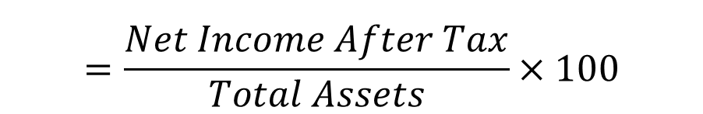

Profitability Ratios
Profitability ratios measure a firm's ability to generate profits.
Key Profitability Ratios
1. Gross Profit Margin
2. Net Profit Margin
3. Return on Asset (ROA)
$$=\frac{Gross Profit}{Net Sales}×100$$
$$=\frac{Net Income After Tax}{Net Sales}×100$$
$$=\frac{Net Income After Tax}{Total Assets}×100$$

Slide 67

Liquidity Ratios
Liquidity refers to the ability of the firm to meet financial short obligations as they come due.
Liquidity ratios measures how many times current assets cover current liabilities.
The common ratio for liquidity is:
(i) Current ratio:
$$=\frac{Current Assents}{Current Liabilities}$$

Slide 68


Solvency Ratios
Solvency Ratios
Solvency relates to the firm’s ability to meet long-term obligations.
Solvency ratios analyse the capital structure of the business. These include:
Debt-to-Equity Ratio
Debt-to-Asset Ratio
$$=\frac{Total Liabilities}{Toal Equity}$$
$$=\frac{Total Liabilities}{Toal Assets}$$

Slide 69
Financial Ratio Analysis: Class Activity
ABC Farm Supply Store Class Activity
ABC Farm Supply Store is an agricultural input retailer located in Chinsali District that sells fertilizers, seeds, agrochemicals, and farming tools to small-scale and commercial farmers. The following condensed financial statements summarize the firm's financial position and Income Statement for the year ended 31 December 2025.

Slide 70
Firm’s Statement of financial position
Assets | ZMW
Current Assets
Cash | 171,000
Accounts Receivable | 698,000
Inventory | 897,000
Total Current Assets | 1,766,000
Fixed Assets | 2,482,000
Total Assets | 4,248,000
Liabilities and Owner’s Equity | ZMW
Current Liabilities
Accounts Payable | 483,000
Notes Payable | 565,000
Total Current Liabilities | 1,048,000
Long-Term Liabilities | 2,000,000
Total Liabilities | 3,048,000
Owner’s Contribution | 1,000,000
Retained Earnings | 200,000
Total Owner’s Equity | 1,200,000
Total Liabilities and Owner’s Equity | 4,248,000

Slide 71
Condensed Statement of Profit or Loss
Item | ZMW
Net Sales | 5,215,000
Cost of Goods Sold | 3,285,450
Gross Margin | 1,929,550
Operating Expenses | 1,202,423
Administrative Expenses | 320,646
Other Expenses | 80,161
Total Operating Expenses | 1,603,230
Net Operating Income | 326,320
Interest Expense | 152,400
Net Income Before Tax | 173,920
Income Tax | 42,480
Net Income After Tax | 131,440

Slide 72
Class Activity Question
Using the financial information provided, calculate the following ratios and briefly interpret the results:
(a) Profitability Ratios
Gross Profit Margin
Net Profit Margin
Return on Assets
(b) Liquidity Ratio
Current Ratio
(c) Solvency Ratios: (i) Debt-Equity Ratio & (ii) Debt-Asset Ratio

Slide 73
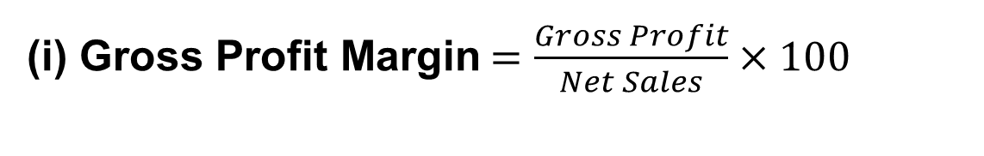
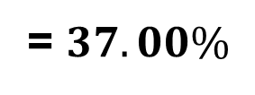

ABC Farm Supply Store Step by Step Solution
We calculate each ratio
(a) Profitability Ratios: (i) Gross Profit Margin, (ii) Net Profit Margin & (iii) Return on Assets
(i) Gross Profit Margin$=\frac{Gross Profit}{Net Sales}×100$
1,929,550
$$=\frac{}{ }×100$$
5,215,000
= $37.00\%$
Interpretation
ABC Farm Supply Store earns a gross profit of 37% on its sales revenue. This means that for every ZMW 100 of sales, ZMW 37 remains after covering the direct cost of goods sold. A higher gross profit margin indicates effective pricing and cost control.

Slide 74
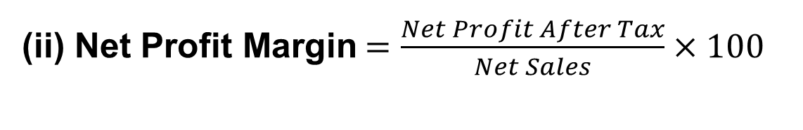
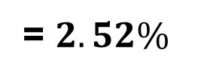
ABC Farm Supply Store Step by Step Solution
We calculate each ratio
(a) Profitability Ratios: Gross Profit Margin, Net Profit Margin & Return on Assets
(ii) Net Profit Margin$=\frac{Net Profit After Tax}{Net Sales}×100$
131,440
$$=\frac{}{ }×100$$
5,215,000
= $2.52\%$
Interpretation
ABC Farm earns a net profit of 2.52% on sales. This means that for every ZMW 100 of revenue generated, only ZMW 2.52 remains as profit after all expenses, interest, and taxes have been paid.

Slide 75

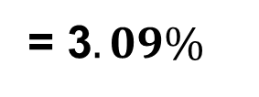
ABC Farm Supply Store Step by Step Solution
We calculate each ratio
(a) Profitability Ratios: Gross Profit Margin, Net Profit Margin & Return on Assets
(iii) Return on Assets$=\frac{Net Profit After Tax}{Total Assets}×100$
131,440
$$=\frac{}{ }×100$$
4,248,000
Interpretation
ABC Farms generates 3.09% profit from its total asset investment. This means every ZMW 100 invested in assets produces ZMW 3.09 in net profit. ROA is normally expressed as a percentage (%), not as a simple ratio.
= 3$.09\%$

Slide 76

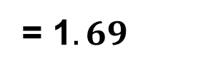



ABC Farm Supply Store Step by Step Solution
We calculate each ratio
(b) Liquidity Ratios:
(i) Current$Ratio =\frac{Current Assets}{Current Liabilities}$
$$1,766,000$$
$$=\frac{}{ }$$
$$1,048,000$$
= 1$.69$
Interpretation
ABC Farms has ZMW 1.69 of current assets for every ZMW 1.00 of current liabilities. Since the ratio is greater than 1, the firm is capable of meeting its short-term obligations as they fall due. The Current Ratio is expressed as a ratio (1.69:1), not as a percentage.

Slide 77

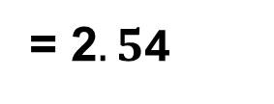


ABC Farm Supply Store Step by Step Solution
We calculate each ratio
(c) Solvency Ratio: (i) Debt-Equity Ratio & (ii) Debt-Asset Ratio
(i) D$ebt−to−Equity Ratio=\frac{Total Liabilities}{Equity}$
$$3,048,000$$
$$=\frac{}{ }$$
$$1,200,000$$
= 2$.5$4
Interpretation
ABC Farms has ZMW 2.54 of debt for every ZMW 1.00 invested by the owner. This indicates a high level of financial leverage and dependence on borrowed funds.
Note: Debt-to-Equity Ratio is expressed as a ratio (2.54:1).

Slide 78
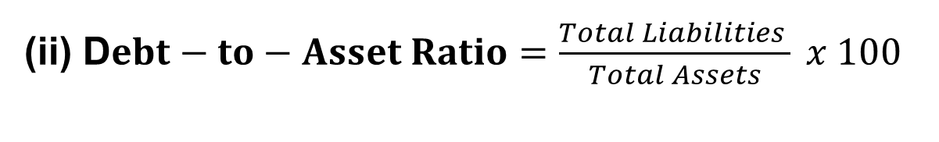
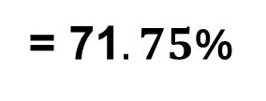



ABC Farm Supply Store Step by Step Solution
We calculate each ratio
(c) Solvency Ratio: (i) Debt-Equity Ratio & Debt-Asset Ratio
(ii) D$ebt−to−Asset Ratio=\frac{Total Liabilities }{Total Assets} x 100$
$$3,048,000$$
$=\frac{}{ }$ x 100
$$4,248,000$$
= 71$.75$%
Interpretation
About 71.75% of ABC Farm’s assets are financed through debt, while the remaining 28.25% are financed through owner's equity. This suggests a relatively high dependence on borrowed capital

Slide 79
Conclusion
Bookkeeping is fundamental to financial management.
It is the source of accounting information necessary for financial decision making
Financial statements; Balance sheets & Income statements arise from the bookkeeping process
Understanding and interpreting financial statements is crucial for financial decision making within agribusiness
Thus, Lecture 7 covered fundamental of bookkeeping and financial analysis

Slide 80
The End

Slide 81
References
Wood, F., & Sangster, A. (2005). Frank Wood’s Business Accounting 1 (10th ed., Vol. 1). Pearson Education Limited.
BPP Learning Media Ltd. (2013). ACCA F3 financial accounting study text (3rd ed.). BPP Learning Media Ltd.

